Slide 1
Human Computer Interaction
UE17CS424
LO-FI PROTOTYPE
Team:DHEERAJ REDDY PES1201700830
DR SAI PRANEETH PES1201701094
NAVEEN G PES1201701439
SYED ALI HUSSAIN PES1201802391

Slide 2
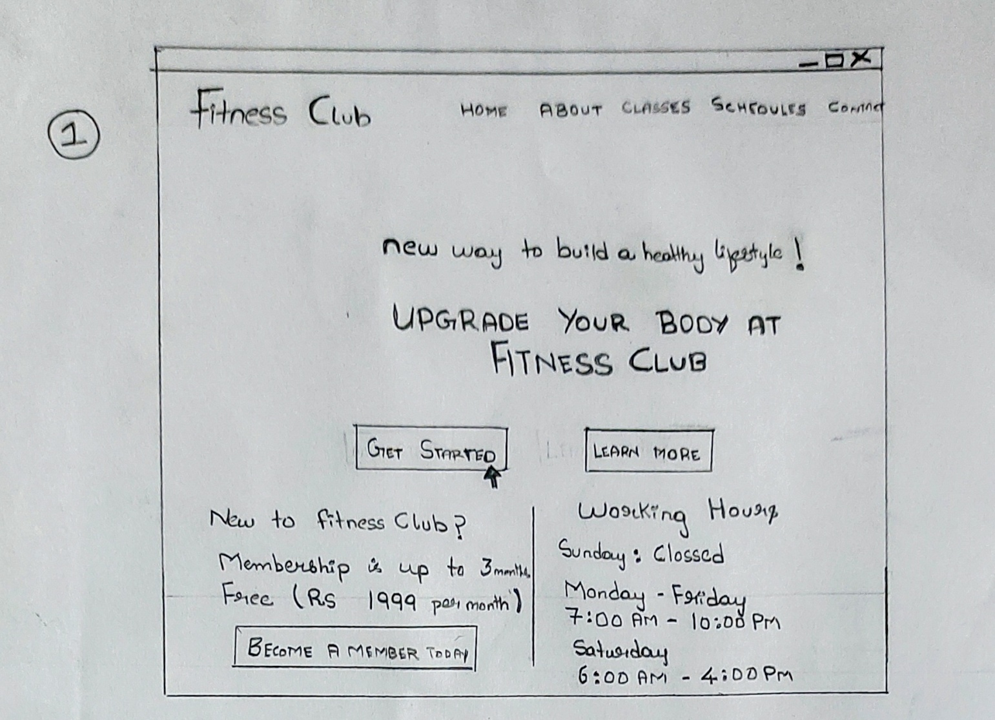
LO-FI PROTOTYPE

Slide 3
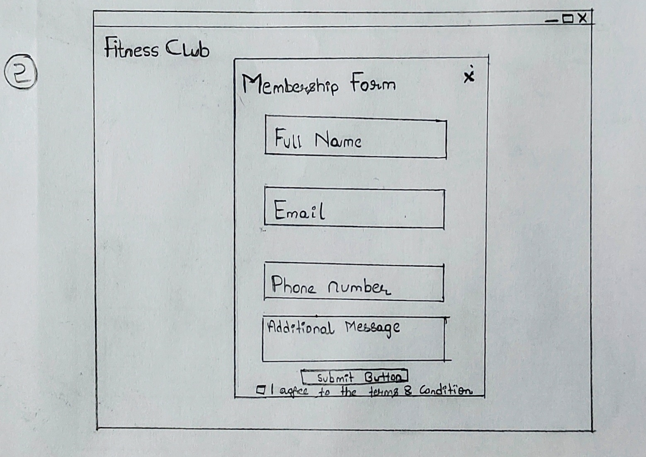
LO-FI PROTOTYPE

Slide 4
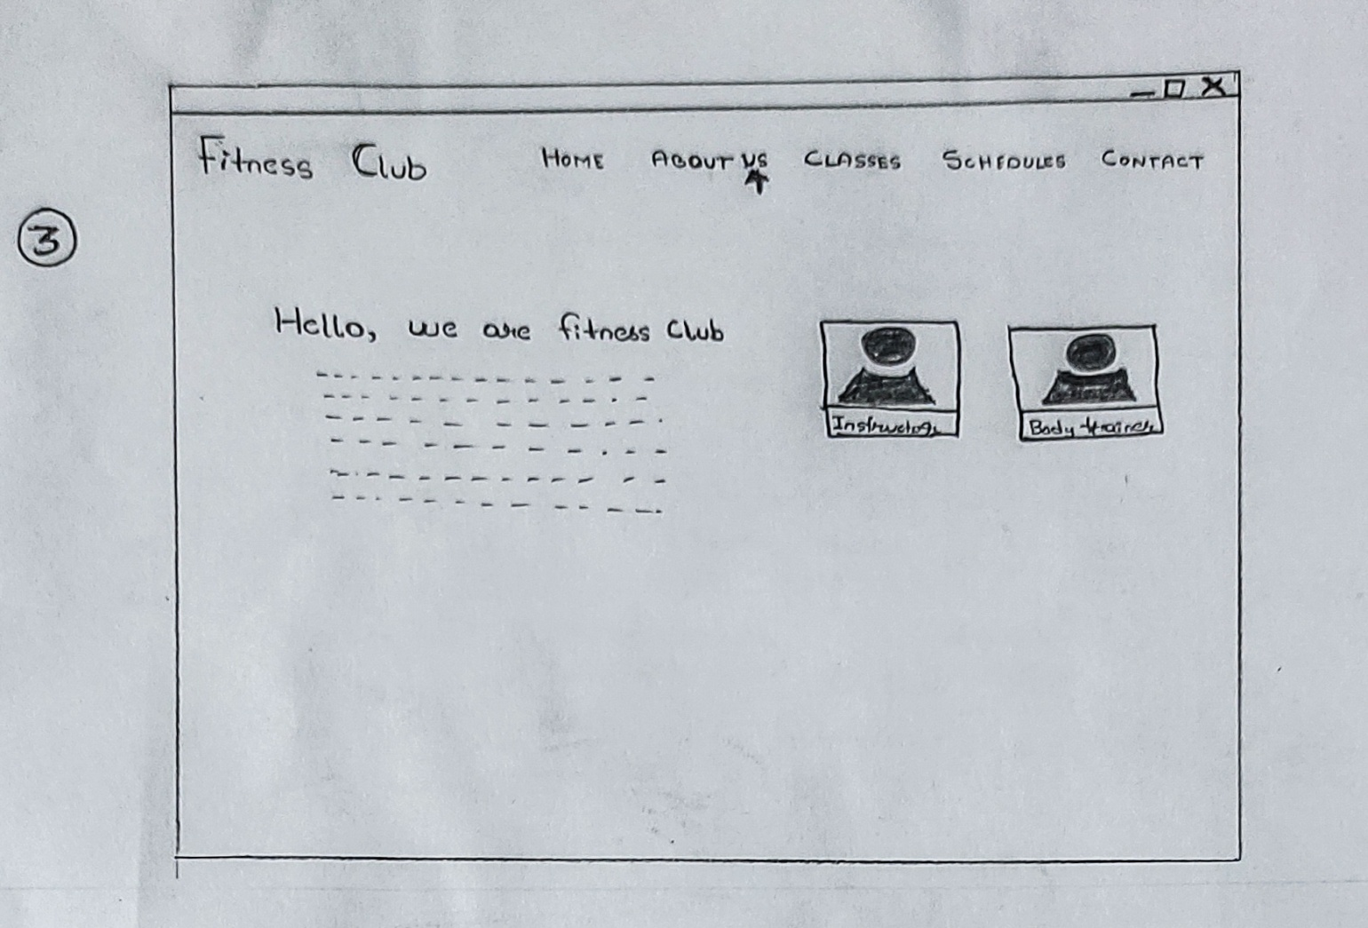
LO-FI PROTOTYPE

Slide 5
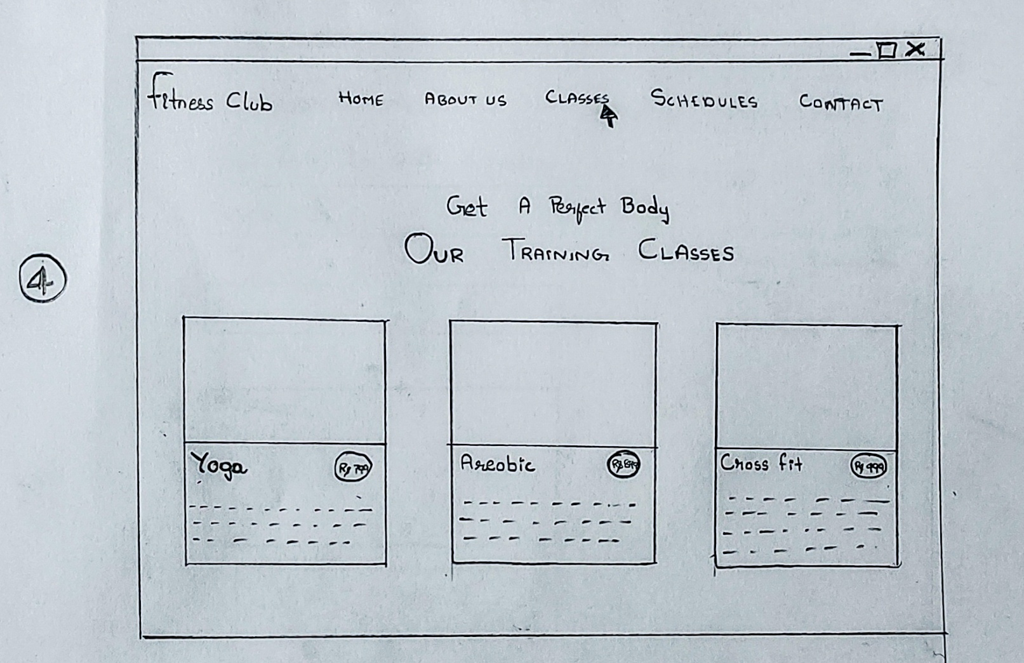
LO-FI PROTOTYPE

Slide 6
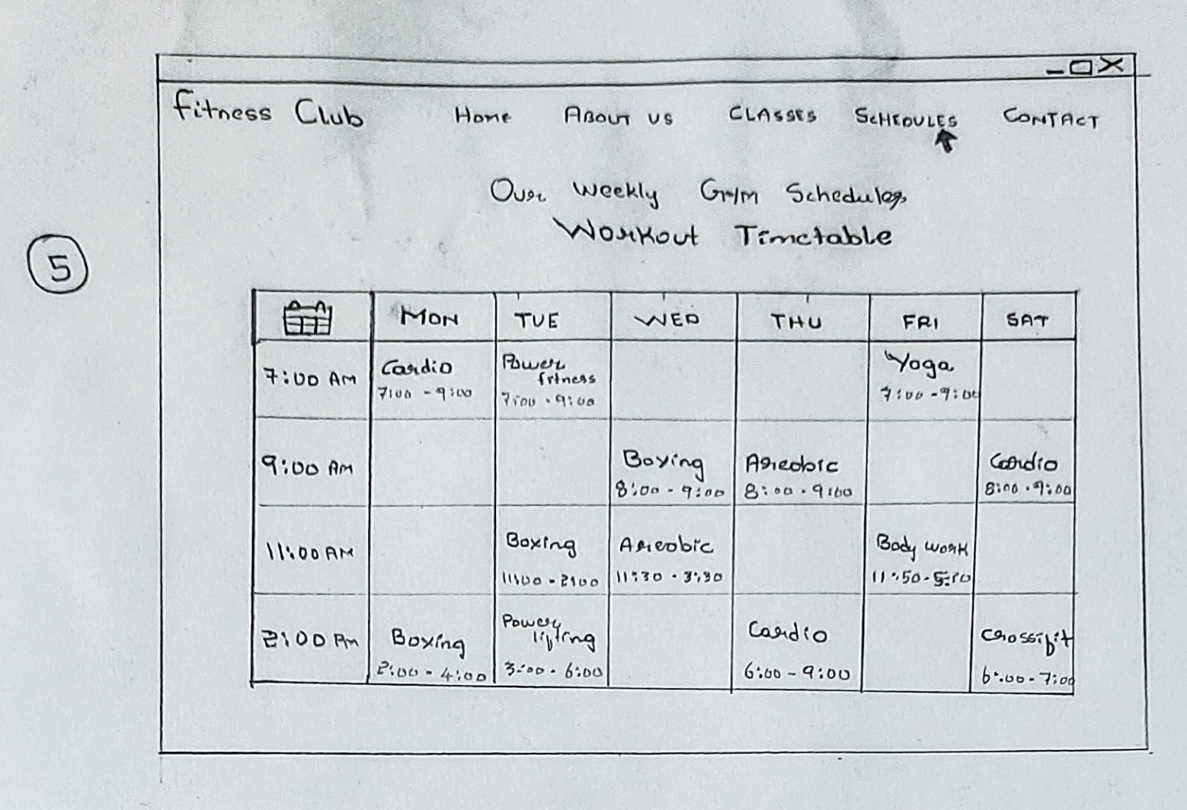
LO-FI PROTOTYPE

Slide 7
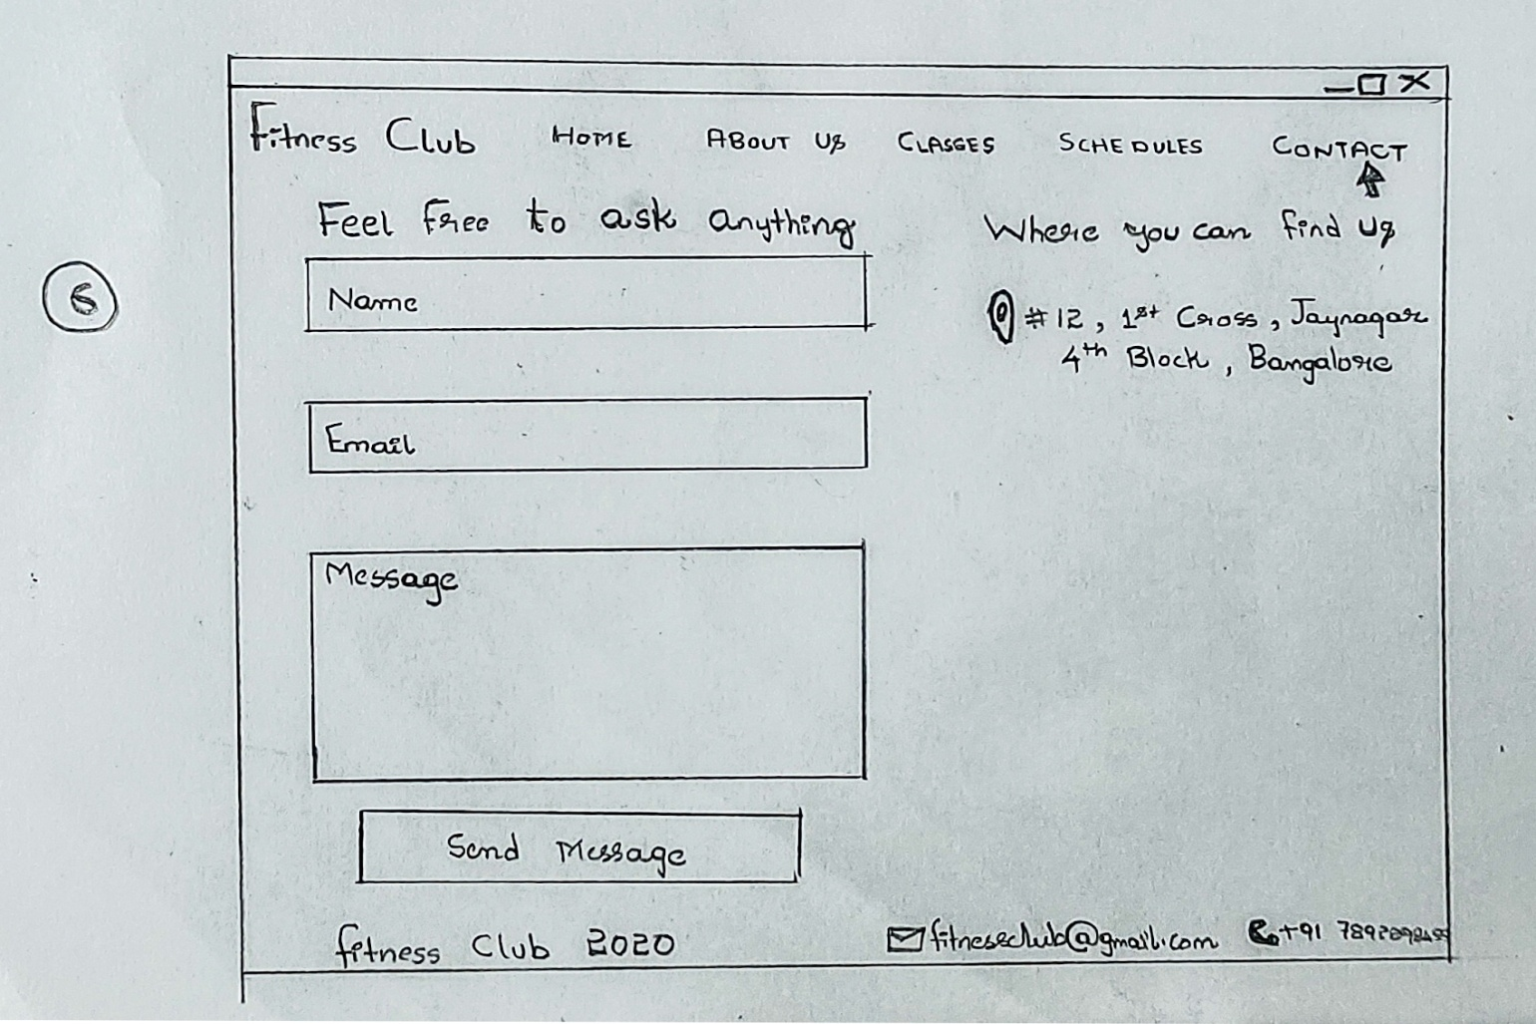
LO-FI PROTOTYPE

